Slide 1
Plotting in Python
18ESC108A Elements of Computer Science and Engineering
B. Tech. 2018
Ami Rai E.
Roopa G
Chaitra S
Department of Computer Science and Engineering
Faculty of Engineering and Technology
Ramaiah University of Applied Sciences

Slide 2
Objectives
At the end of this lecture, student will be able to
Understand matplotlib plotting package and numpy module
Apply matplotlib and numpy for applications

Slide 3
Topics
Visualization
Matplotlib
Numpy

Slide 4
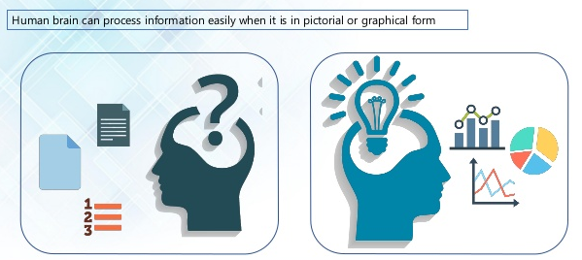
Visualization
Visualization is any technique for creating images, diagrams, or animations to communicate a message
Easy to Understand [ Graphs, Line Charts etc. ]

Slide 5
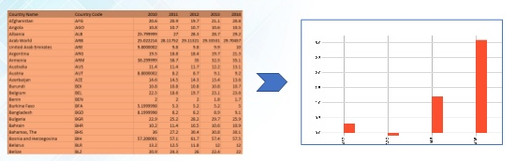
Matplotlib
Matplotlib is a python 2D plotting library which produces publication quality figures in a variety of hardcopy formats and interactive environments

Slide 6
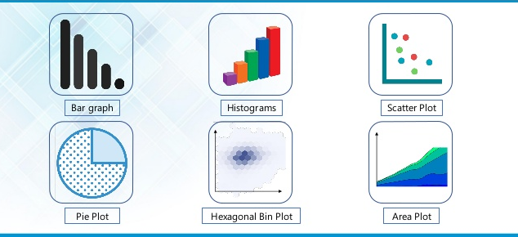
Types of Plots

Slide 7
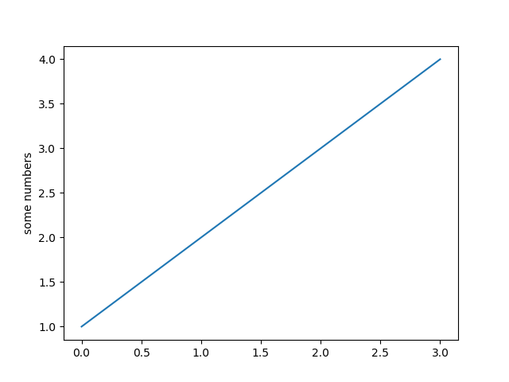
Plotting Single Line – Example 1
# importing the required module
import matplotlib.pyplot as plt
# plotting the points
plt.plot([1,2,3,4])
# naming the y-axis
plt.ylabel('some numbers')
#show function
plt.show()

Slide 8
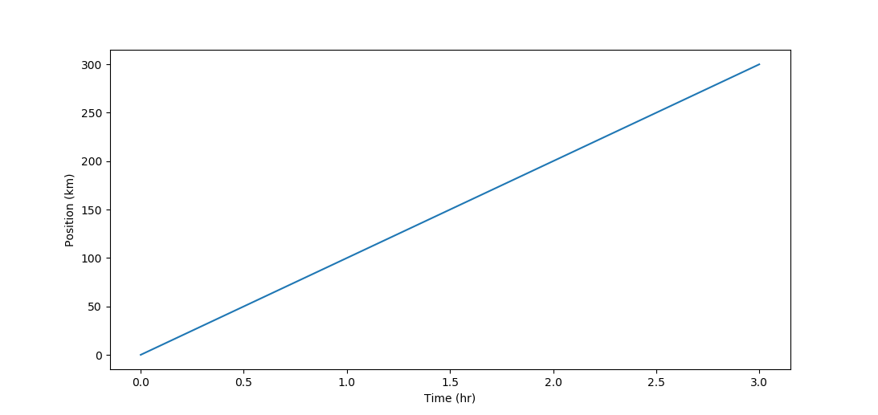
Plotting Single Line – Example 2
# importing the required module
import matplotlib.pyplot as plt
# x-axis and y-axis values
time = [0, 1, 2, 3]
position = [0, 100, 200, 300]
# plotting the points
plt.plot(time, position)
# naming the x axis and y-axis
plt.xlabel('Time (hr)')
plt.ylabel('Position (km)')

Slide 9
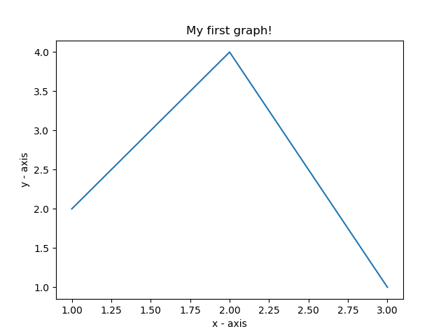
Plotting Single Line – Example 3
import matplotlib.pyplot as plt
x = [1,2,3]
y = [2,4,1]
plt.plot(x, y)
plt.xlabel('x - axis')
plt.ylabel('y - axis')
# giving a title to the graph
plt.title('My first graph!')
plt.show()

Slide 10
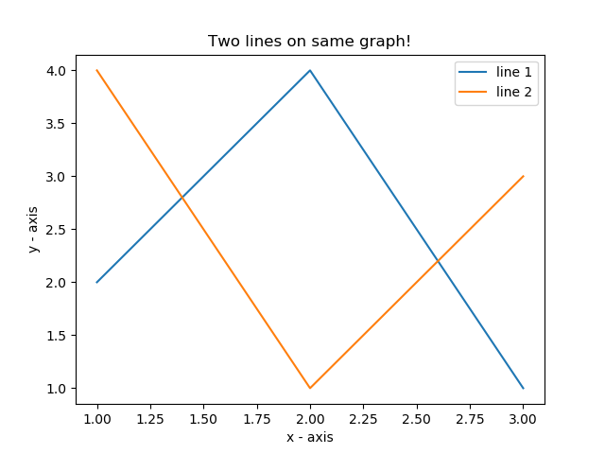
Plotting Multiple Line
# line 1 points
x1 = [1,2,3]
y1 = [2,4,1]
# plotting the line 1 points
plt.plot(x1, y1, label = "line 1")
# line 2 points
x2 = [1,2,3]
y2 = [4,1,3]
# plotting the line 2 points
plt.plot(x2, y2, label = "line 2")
# naming the x axis
plt.xlabel('x - axis')
# naming the y axis
plt.ylabel('y - axis')
# giving a title to the graph
plt.title('Two lines on same graph!')
# show a legend on the plot
plt.legend()
plt.show()

Slide 11
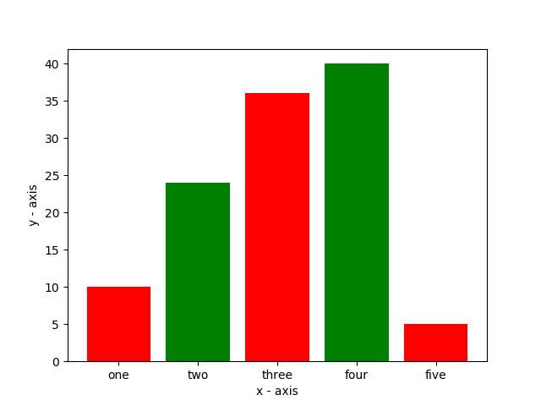
Bar Chart
# x-coordinates of left sides of bars
left = [1, 2, 3, 4, 5]
# heights of bars
height = [10, 24, 36, 40, 5]
# labels for bars
tick_label = ['one', 'two', 'three', 'four', 'five']
# plotting a bar chart
plt.bar(left, height, tick_label = tick_label,
width = 0.8, color = ['red', 'green'])
# naming the x-axis, y-axis
plt.xlabel('x - axis')
plt.ylabel('y - axis')
plt.show()

Slide 12
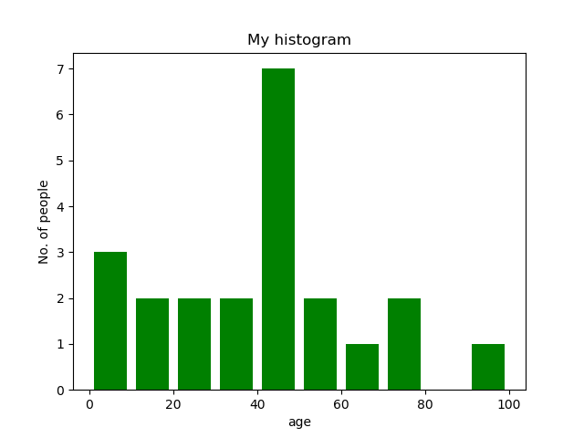
Histogram
# frequencies
ages = [2,5,70,40,30,45,50,45,43,40,44,
60,7,13,57,18,90,77,32,21,20,40]
# setting the ranges and no. of intervals
range = (0, 100)
bins = 10
# plotting a histogram
plt.hist(ages, bins, range, color = 'green',
histtype = 'bar', rwidth = 0.8)
plt.xlabel('age')
plt.ylabel('No. of people')
plt.title('My histogram')

Slide 13
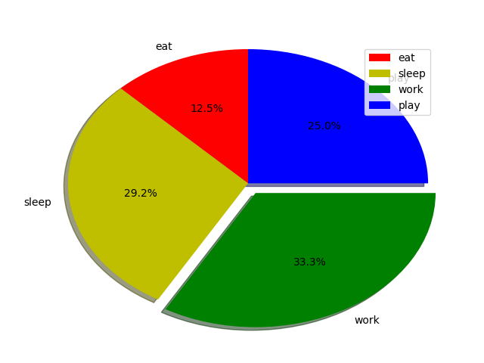
Pie Chart
# defining labels
activities = ['eat', 'sleep', 'work', 'play']
# portion covered by each label
slices = [3, 7, 8, 6]
# color for each label
colors = ['r', 'y', 'g', 'b']
# plotting the pie chart
plt.pie(slices, labels = activities, colors=colors,
startangle=90, shadow = True, explode = (0, 0, 0.1, 0),
radius = 1.2, autopct = '%1.1f%%')
# plotting legend
plt.legend()
plt.show()

Slide 14
Numpy
NumPy is the fundamental package for scientific computing with Python
NumPy is module for Python
The name is an acronym for "Numeric Python" or "Numerical Python“
This makes sure that the precompiled mathematical and numerical functions and functionalities of Numpy guarantee great execution speed
NumPy is not part of a basic Python installation
It has to be installed after the Python installation

Slide 15
Numpy - Example
from numpy import *
a=array([1,2,3,4])
b=array([1,2,3,4])
print(a + b) #Element wise addition
[2 4 6 8]

Slide 16
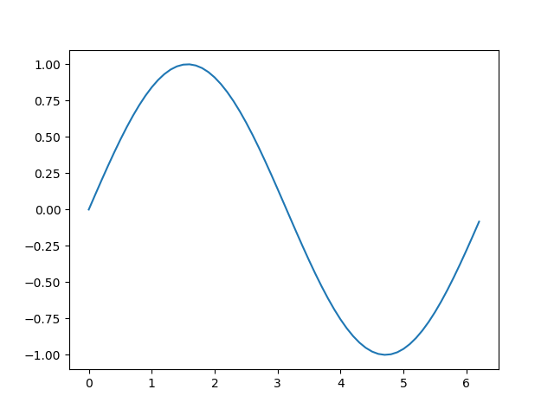
Plotting Curves of Given Equation
# importing the required modules
import matplotlib.pyplot as plt
import numpy as np
# setting the x - coordinates
x = np.arange(0, 2*(np.pi), 0.1)
# setting the corresponding y - coordinates
y = np.sin(x)
# potting the points
plt.plot(x, y)
plt.show()

Slide 17
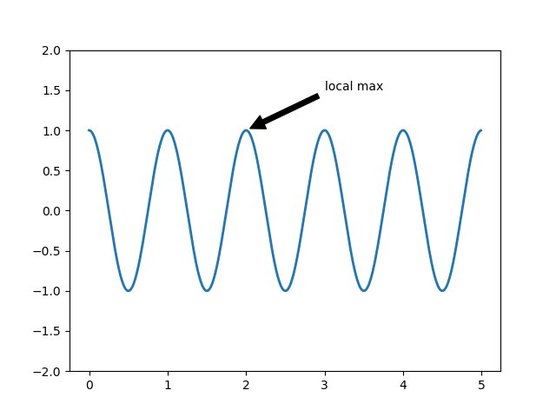
Annotating Text
import numpy as np
import matplotlib.pyplot as plt
ax = plt.subplot(111)
t = np.arange(0.0, 5.0, 0.01)
s = np.cos(2*np.pi*t)
line, = plt.plot(t, s, lw=2)
plt.annotate('local max', xy=(2, 1), xytext=(3, 1.5),
arrowprops=dict(facecolor='black', shrink=0.05),)
plt.ylim(-2,2)
plt.show()

Slide 18
Summary
Visualization is any technique for creating images, diagrams, or animations to communicate a message
Matplotlib is a python 2D plotting library which produces publication quality figures in a variety of hardcopy formats and interactive environments
NumPy is the fundamental package for scientific computing with Python

